Slide 1


AUTOMATIC STREET LIGHT FAULT DETECTION SYSTEM USING LIGHT DEPENDENT RESISTOR
KNOWLEDGE INSTITUTE OF TECHNOLOGY
(AUTONOMOUS)
Presented by
ARUN RG (611220104007)
BALAJI SS (611220104016)
DEEPESH KUMAR S (611220104028)
GOKUL HARI R (611220104048)
UNDER THE GUIDANCE OF
Mr. T. KARTHIKEYAN M.S (IT)., (Ph.D).,
ASSISTANT PROFESSOR,
DEPARTMENT OF COMPUTER SCIENCE AND ENGINEERING

Slide 2
TABLE OF CONTENTS
AUTOMATIC STREET LIGHT FAULT DETECTION SYSTEM USING LIGHT DEPENDENT RESISTOR
(AUTONOMOUS)
S. NO. | CONTENTS
1 | Abstract
2 | Introduction
3 | Literature Survey Papers
4 | Existing System (Drawbacks)
5 | Proposed System (Advantages)
6 | Workflow Diagram
7 | System Specification
8 | Modules
CSE
16-04-2024 GUIDE: Mr. T. KARTHIKEYAN, AP/CSE 01

Slide 3
TABLE OF CONTENTS
AUTOMATIC STREET LIGHT FAULT DETECTION SYSTEM USING LIGHT DEPENDENT RESISTOR
KNOWLEDGE INSTITUTE OF TECHNOLOGY
(AUTONOMOUS)
S. NO. | CONTENTS
8 | Screenshots
9 | Result and Discussion
10 | Conclusion and Future Enhancement
11 | Publication and Certifications
12 | References
CSE
16-04-2024 GUIDE: Mr. T. KARTHIKEYAN, AP/CSE 02

Slide 4
ABSTRACT
AUTOMATIC STREET LIGHT FAULT DETECTION SYSTEM USING LIGHT DEPENDENT RESISTOR
“LightSense” aims to revolutionize urban lighting infrastructure by introducing an automated system for real-time street light fault detection, precise location tracking, and efficient maintenance. The current reliance on public reports or periodic surveys is time-consuming and inefficient. The project suggests a cost-effective solution utilizing Light Dependent Resistor (LDR) sensors integrated into a board connected to a Modular Network Module for detecting changes in light intensity or the absence of light. A unique identification number for each street light pole, is transmitted to a regional hub and then relayed to the nearest Electricity Board (EB) Office mainframe for precise location determination and technician dispatch. The system goes beyond fault detection, providing a versatile framework for future enhancements. The project's workplan includes milestones, and the college facilities available for prototype development are essential. Industry support is sought, and financial assistance is required. The expected outcomes include faster response times, reduced costs, and overall improved urban lighting infrastructure.
CSE
16-04-2024 GUIDE: Mr. T. KARTHIKEYAN, AP/CSE 03

Slide 5
INTRODUCTION
AUTOMATIC STREET LIGHT FAULT DETECTION SYSTEM USING LIGHT DEPENDENT RESISTOR
KNOWLEDGE INSTITUTE OF TECHNOLOGY
(AUTONOMOUS)
Traditional methods of detecting and addressing faults in streetlights present significant challenges, often resulting in delays, inefficiencies, and increased costs.
Public reports are often unreliable and difficult to prioritize among the vast number of reports received. On the other hand, periodic surveys conducted by technicians are time-consuming and inefficient, often taking days or even months to complete.
Recognizing the need for optimization, this project proposes a novel solution leveraging wide-scale Internet of Things (IoT) technologies to revolutionize the detection and reporting of faults in street lighting infrastructure.
CSE
16-04-2024 GUIDE: Mr. T. KARTHIKEYAN, AP/CSE 04

Slide 6
LITERATURE SURVEY PAPER-1
AUTOMATIC STREET LIGHT FAULT DETECTION SYSTEM USING LIGHT DEPENDENT RESISTOR
KNOWLEDGE INSTITUTE OF TECHNOLOGY
(AUTONOMOUS)
Title | AUTHOR | YEAR | DESCRIPTION | ADVANTAGES | DISADVANTAGES
Smart Streetlights In Smart City: A Case Study Of Sheffield | Dizon, E., & Pranggono, B., | 2022 | The study evaluates utilities of smart streetlight in the city of Sheffield, comparing it against traditional standards and found out some interesting correlations | The Study found that there is a correlation between crime rate and availability of streetlight, crucially it is inversely propositional to each other. | The study mainly focuses on benefits of high availability streetlights but not how to maintain such system.
CSE
16-04-2024 GUIDE: Mr. T. KARTHIKEYAN, AP/CSE 05

Slide 7
LITERATURE SURVEY PAPER-2
AUTOMATIC STREET LIGHT FAULT DETECTION SYSTEM USING LIGHT DEPENDENT RESISTOR
KNOWLEDGE INSTITUTE OF TECHNOLOGY
(AUTONOMOUS)
Title | AUTHOR | YEAR | DESCRIPTION | ADVANTAGES | DISADVANTAGES
Smart Streetlight System Using Mobile Applications: Secured Fault Detection And Diagnosis With Optimal Powers | M. Kanthi., & Ravilla Dilli | 2023 | The work focuses on implementing power efficient streetlights by using LDRs to control the lamp based on the environment light deficiency. | The work has effectively saved approximately 53.45%, 44.76%, 39.39%, and 32.25% respectively for 10%, 20%, 30%, and 50% idle mode brightness. | The Work uses Radio and Bluetooth networking modules, which would only work on extremely short ranges. The work also do not have means to maintain multiple streetlights simultaneously limiting its scalability.
CSE
16-04-2024 GUIDE: Mr. T. KARTHIKEYAN, AP/CSE 06

Slide 8
LITERATURE SURVEY PAPER-3
AUTOMATIC STREET LIGHT FAULT DETECTION SYSTEM USING LIGHT DEPENDENT RESISTOR
KNOWLEDGE INSTITUTE OF TECHNOLOGY
(AUTONOMOUS)
Title | AUTHOR | YEAR | DESCRIPTION | ADVANTAGES | DISADVANTAGES
Iot Based Automatic Damaged Street Light Fault Detection Management System | Ashok Kumar Nanduri, Siva Kumar Kotamraju, G L Sravanthi, Sadhu Ratna Babu | 2020 | The project uses LDRs, GPS, Twillio to maintain and identify faults in the streetlight automatically. | The project uses environment LDR to forgo the use of NTP to get context of day-night. | The project uses GPS for location tracking, which is an extra component that increases the complexity of the system. It also is tightly coupled with its network module which is GSM.
CSE
16-04-2024 GUIDE: Mr. T. KARTHIKEYAN, AP/CSE 07

Slide 9
LITERATURE SURVEY PAPER-4
AUTOMATIC STREET LIGHT FAULT DETECTION SYSTEM USING LIGHT DEPENDENT RESISTOR
KNOWLEDGE INSTITUTE OF TECHNOLOGY
(AUTONOMOUS)
Title | AUTHOR | YEAR | DESCRIPTION | ADVANTAGES | DISADVANTAGES
Street Light Controlling And Monitoring Of Fault Detection Using Lora | N. Sravani, Y. Latha, G. Nirmala | 2021 | The study presents a dual-model where one model utilizes IEEE 802.11 wireless technology within confined premises, while the other employs a wired setup for extended ranges, suitable for streetlamps. | The use of a short range and long-range networking modules significantly increases its adaptability. | The system is tightly coupled to those two standards, which limits scalability on areas with extreme conditions. The need of modular networking is evident here.
CSE
16-04-2024 GUIDE: Mr. T. KARTHIKEYAN, AP/CSE 08

Slide 10
LITERATURE SURVEY PAPER-5
AUTOMATIC STREET LIGHT FAULT DETECTION SYSTEM USING LIGHT DEPENDENT RESISTOR
KNOWLEDGE INSTITUTE OF TECHNOLOGY
(AUTONOMOUS)
Title | AUTHOR | YEAR | DESCRIPTION | ADVANTAGES | DISADVANTAGES
Simulators, Emulators, And Test-beds For Internet Of Things: A Comparison | N D Patel, B M Mehtre, Rajeev Wankar | 2019 | The paper compares various simulators, emulators, and testbeds for IoT, focusing on their scope, type, programming language, IoT layers, scale of operation, and security measures. | With the evaluations one can easily test out the initial implementation of a IoT system without having to physically assembling the system. | The study’s emulator, simulator and testbed were remained largely unhelpful, however it set us on right path in finding our effective emulator: WokWi.
CSE
16-04-2024 GUIDE: Mr. T. KARTHIKEYAN, AP/CSE 09

Slide 11
EXISTING SYSTEM (DRAWBACKS)
AUTOMATIC STREET LIGHT FAULT DETECTION SYSTEM USING LIGHT DEPENDENT RESISTOR
KNOWLEDGE INSTITUTE OF TECHNOLOGY
(AUTONOMOUS)
The current management of street lighting infrastructure relies on manual methods for fault detection and reporting.
The reliance on manual processes for fault detection and reporting in street lighting infrastructure poses several challenges.
Public reports are often sporadic and unreliable, while surveys are time-consuming and may not comprehensively cover all areas.
These issues contribute to increased downtime, maintenance costs, and a diminished quality of urban lighting infrastructure.
CSE
16-04-2024 GUIDE: Mr. T. KARTHIKEYAN, AP/CSE 10

Slide 12
PROPOSED SYSTEM (ADVANTAGES)
AUTOMATIC STREET LIGHT FAULT DETECTION SYSTEM USING LIGHT DEPENDENT RESISTOR
KNOWLEDGE INSTITUTE OF TECHNOLOGY
(AUTONOMOUS)
Recognizing the need for optimization, this project proposes a novel solution leveraging wide-scale Internet of Things (IoT) technologies to revolutionize the detection and reporting of faults in street lighting infrastructure.
This system is loosely coupled from networking module and is designed so it can be changed with minimal code change.
Allows for the dynamic control of streetlights and sends maintenance alerts for issues like burnt-out bulbs.
The system goes beyond fault detection, providing a versatile framework for future enhancements.
CSE
16-04-2024 GUIDE: Mr. T. KARTHIKEYAN, AP/CSE 11

Slide 13
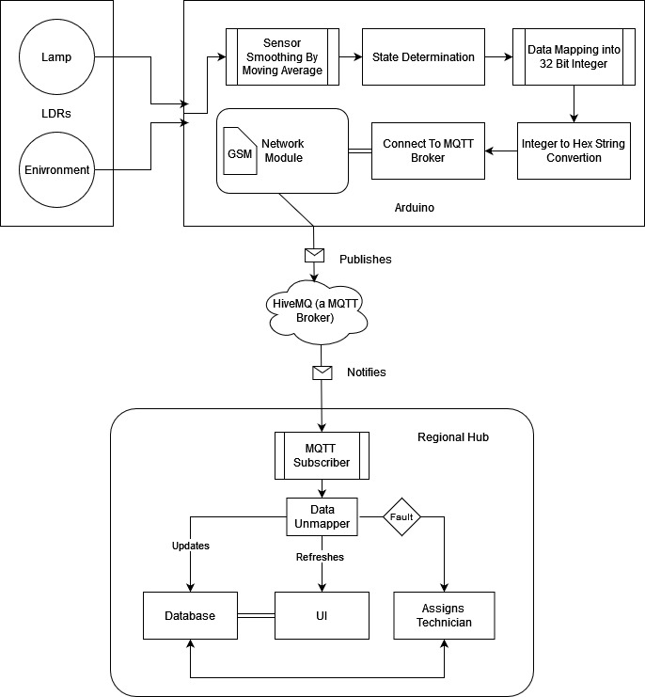
WORKFLOW DIAGRAM
AUTOMATIC STREET LIGHT FAULT DETECTION SYSTEM USING LIGHT DEPENDENT RESISTOR
KNOWLEDGE INSTITUTE OF TECHNOLOGY
(AUTONOMOUS)
CSE
16-04-2024 GUIDE: Mr. T. KARTHIKEYAN, AP/CSE 12

Slide 14
SYSTEM SPECIFICATION
AUTOMATIC STREET LIGHT FAULT DETECTION SYSTEM USING LIGHT DEPENDENT RESISTOR
KNOWLEDGE INSTITUTE OF TECHNOLOGY
(AUTONOMOUS)
HARDWARE SPECIFICATION
Board : Arduino UNO R3 / ESP32 Devkit
Sensor : Light Dependent Resistor
Networking Module : SIM800L GSM / Wi-Fi Module in ESP32
Computer : PC/Laptop with USB Port
SOFTWARE SPECIFICATION
Programming Languages : Python, Micropython, Arduino C++
GUI Framework : CustomTKinter
MQTT Broker : HiveMQ
DBMS : MySQL
Stimulation Tool : WokWi
CSE
16-04-2024 GUIDE: Mr. T. KARTHIKEYAN, AP/CSE 13

Slide 15
MODULES
AUTOMATIC STREET LIGHT FAULT DETECTION SYSTEM USING LIGHT DEPENDENT RESISTOR
KNOWLEDGE INSTITUTE OF TECHNOLOGY
(AUTONOMOUS)
The Modules included in a project are
1. Sensor Data Collection
2. Data Masking
3. Data Transmission
4. Data Storage
5. Data Monitoring and Visualization
CSE
16-04-2024 GUIDE: Mr. T. KARTHIKEYAN, AP/CSE 14

Slide 16
(SENSOR DATA COLLECTION)
AUTOMATIC STREET LIGHT FAULT DETECTION SYSTEM USING LIGHT DEPENDENT RESISTOR
KNOWLEDGE INSTITUTE OF TECHNOLOGY
(AUTONOMOUS)
MODULE 1
CSE
There are two LDR Sensors, Lamp LDR which is placed such that it faces the bulb of the light pole, and the environment LDR which is exposed to the sky and placed such that it is isolated from the Lamp LDR..
The environment LDR gives the context like night, dusk, dawn and day, and lamp LDR must be greater than environment during night and dusk.
Since the LDR are connected in voltage divider circuit the resistance of the second resistor must be one magnitude higher than the LDR ohm range to get a readable voltage that makes sense during night and daytime .
16-04-2024 GUIDE: Mr. T. KARTHIKEYAN, AP/CSE 15

Slide 17
(Data Masking)
AUTOMATIC STREET LIGHT FAULT DETECTION SYSTEM USING LIGHT DEPENDENT RESISTOR
KNOWLEDGE INSTITUTE OF TECHNOLOGY
(AUTONOMOUS)
MODULE 2
Data Masking is done to pack as much data as possible within a unit of storage, therefore this step is more akin to data packing or data compression, the masking part is the one that achieves it.
The MCU would publish four pieces of data to the broker server: ID of the light pole, Lamp LDR value, Environment LDR value and finally the state of the lamp.
The ADC in Arduino board would only resolve up to 10-bit (0-1023) so the values of both LDR is essentially capped at 0-1023 and finally the state/condition of the lamp would only have three states: working, sleeping and fault, which can be represented in 2 -bit number.
CSE
16-04-2024 GUIDE: Mr. T. KARTHIKEYAN, AP/CSE 16

Slide 18
(DATA TRANSMISSION)
AUTOMATIC STREET LIGHT FAULT DETECTION SYSTEM USING LIGHT DEPENDENT RESISTOR
KNOWLEDGE INSTITUTE OF TECHNOLOGY
(AUTONOMOUS)
MODULE 3
CSE
SIM800L GSM module is responsible for establishing a cellular connection to transmit the collected data.
The module is programmed to publish data at regular intervals, specifically every 10 seconds, ensuring a consistent flow of information.
During each cycle of the main loop, the Arduino microcontroller performs a check to ensure that the GSM and the MQTT connection to the broker, are intact and functioning properly.
16-04-2024 GUIDE: Mr. T. KARTHIKEYAN, AP/CSE 17

Slide 19
(DATA STORAGE)
AUTOMATIC STREET LIGHT FAULT DETECTION SYSTEM USING LIGHT DEPENDENT RESISTOR
KNOWLEDGE INSTITUTE OF TECHNOLOGY
(AUTONOMOUS)
MODULE 4
The project employs MySQL database for this purpose. This map’s their unique identifiers to their respective locations. It also maintains a record of registered technicians and repair tasks facilitating efficient tracking.
This also stores sensor data published by the streetlights. By which historical data analysis is done.
The choice of MySQL was primarily driven by familiarity rather than efficiency. While MySQL is a robust and widely used database system
CSE
16-04-2024 GUIDE: Mr. T. KARTHIKEYAN, AP/CSE 18

Slide 20
(DATA MONITORING AND VISUALIZATION)
AUTOMATIC STREET LIGHT FAULT DETECTION SYSTEM USING LIGHT DEPENDENT RESISTOR
KNOWLEDGE INSTITUTE OF TECHNOLOGY
(AUTONOMOUS)
MODULE 5
CSE
A comprehensive interface to monitor sensor data and visualize the status of streetlights in real-time, ensuring efficient management of urban lighting infrastructure.
CustomTkinter, a Python GUI framework that wraps the standard Tkinter library is used. This module provides a user-friendly and visually appealing platform for data visualization and analysis.
16-04-2024 GUIDE: Mr. T. KARTHIKEYAN, AP/CSE 19

Slide 21
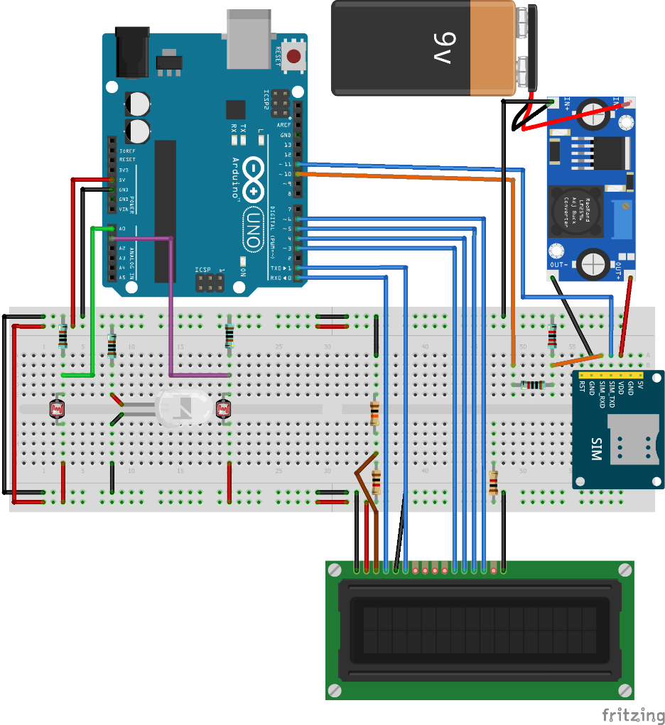
AUTOMATIC STREET LIGHT FAULT DETECTION SYSTEM USING LIGHT DEPENDENT RESISTOR
KNOWLEDGE INSTITUTE OF TECHNOLOGY
(AUTONOMOUS)
SYSTEM ASSEMBLY
CSE
16-04-2024 GUIDE: Mr. T. KARTHIKEYAN, AP/CSE 19

Slide 22
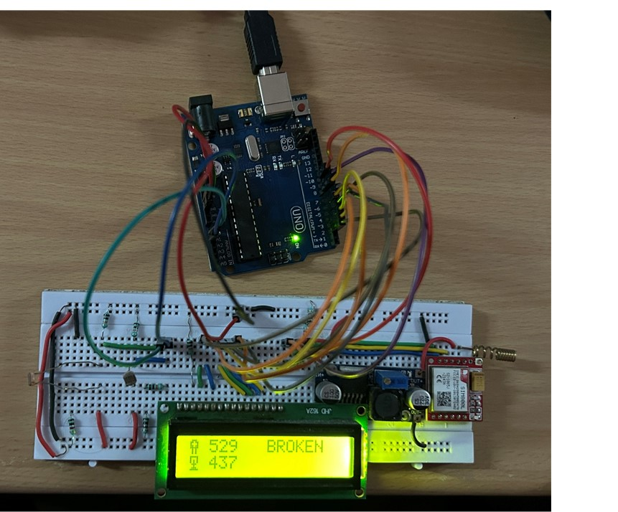
SCREENSHOT 1:
AUTOMATIC STREET LIGHT FAULT DETECTION SYSTEM USING LIGHT DEPENDENT RESISTOR
KNOWLEDGE INSTITUTE OF TECHNOLOGY
(AUTONOMOUS)
SCREENSHOTS
CSE
16-04-2024 GUIDE: Mr. T. KARTHIKEYAN, AP/CSE 20

Slide 23
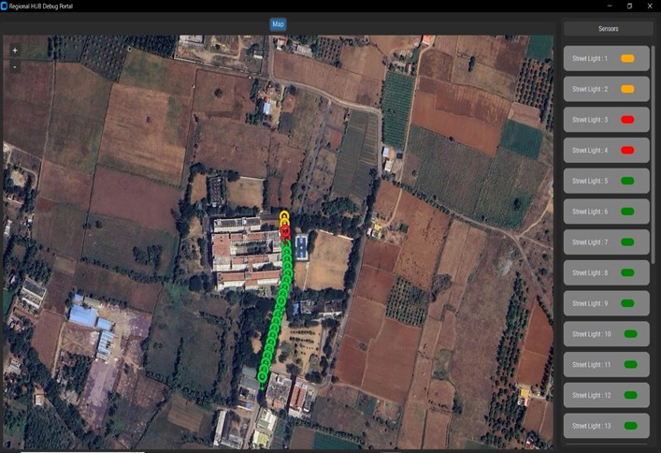
SCREENSHOT 2:
AUTOMATIC STREET LIGHT FAULT DETECTION SYSTEM USING LIGHT DEPENDENT RESISTOR
KNOWLEDGE INSTITUTE OF TECHNOLOGY
(AUTONOMOUS)
CSE
16-04-2024 GUIDE: Mr. T. KARTHIKEYAN, AP/CSE 21

Slide 24
RESULT AND DISCUSSION
AUTOMATIC STREET LIGHT FAULT DETECTION SYSTEM USING LIGHT DEPENDENT RESISTOR
KNOWLEDGE INSTITUTE OF TECHNOLOGY
(AUTONOMOUS)
The proposed streetlight monitoring system addresses the challenges outlined in the problem statement by leveraging modern IoT technologies to enhance urban lighting infrastructure.
By utilizing Light Dependent Resistor (LDR) sensors and modular network modules, this become a cost-effective and scalable approach to streetlight management.
With its ability to improve response times, reduce costs, and enhance overall urban lighting infrastructure, the proposed solution offers a transformative approach to streetlight maintenance in both urban and rural areas.
CSE
16-04-2024 GUIDE: Mr. T. KARTHIKEYAN, AP/CSE 26

Slide 25
CONCLUSION AND FUTURE ENHANCEMENT
AUTOMATIC STREET LIGHT FAULT DETECTION SYSTEM USING LIGHT DEPENDENT RESISTOR
KNOWLEDGE INSTITUTE OF TECHNOLOGY
(AUTONOMOUS)
This system not only optimizes the process of reporting faults but also lays the foundation for future enhancements and innovations.
Incorporating machine learning algorithms can enable predictive maintenance capabilities, allowing the system to anticipate and address potential faults before they occur.
Integrating advanced analytics and visualization tools into the GUI can empower users with deeper insights into streetlight performance and energy consumption trends.
CSE
16-04-2024 GUIDE: Mr. T. KARTHIKEYAN, AP/CSE 27

Slide 26
AUTOMATIC STREET LIGHT FAULT DETECTION SYSTEM USING LIGHT DEPENDENT RESISTOR
KNOWLEDGE INSTITUTE OF TECHNOLOGY
(AUTONOMOUS)
REFERENCES
E. Dizon and B. Pranggono, "Smart streetlights in Smart City: a case study of Sheffield," Journal of Ambient Intelligence and Humanized Computing, 2022.
M. D. R. Kanthi, "Smart streetlight system using mobile applications: secured fault detection and diagnosis with optimal powers," 2023.
B. M. M. a. R. W. N. D. Patel, "Simulators, Emulators, and Test-beds for Internet of Things: A Comparison," in Third International conference on I-SMAC (IoT in Social, Mobile, Analytics and Cloud) (I-SMAC), 2019.
CSE
16-04-2024 GUIDE: Mr. T. KARTHIKEYAN, AP/CSE 30

Slide 27
AUTOMATIC STREET LIGHT FAULT DETECTION SYSTEM USING LIGHT DEPENDENT RESISTOR
KNOWLEDGE INSTITUTE OF TECHNOLOGY
(AUTONOMOUS)
REFERENCES
A. K. Nanduri, S. K. Kotamraju, G. L. Sravanthi, S. R. Babu and K. V. K. V. L. P. Kumar, "IoT based Automatic Damaged Street Light Fault Detection Management System," International Journal of Advanced Computer Science and Applications(IJACSA), 2020.
N. Sravani and Y. L. a. G. Nirmala, "Street Light Controlling and Monitoring of Fault Detection using LoRa," International Journal for Modern Trends in Science and Technology, 2021.
CSE
16-04-2024 GUIDE: Mr. T. KARTHIKEYAN, AP/CSE 31

Slide 28
THANK YOU
AUTOMATIC STREET LIGHT FAULT DETECTION SYSTEM USING LIGHT DEPENDENT RESISTOR
KNOWLEDGE INSTITUTE OF TECHNOLOGY
(AUTONOMOUS)
CSE
16-04-2024 GUIDE: Mr. T. KARTHIKEYAN, AP/CSE 39

